Slide 1


What is Microsoft Dataverse? A Complete Guide
Trainer: Dhruv

Slide 2
Thoughts
Data. It’s such a small word, but it’s literally at the heart of everything we do. It doesn’t matter if you’re a small business or a large enterprise; you need reliable data to do what you do.
More important than just “having” data is the ability to use it and capture it securely and quickly. Then you must be able to analyze it in real-time to inform better data-driven business decisions. Unfortunately, that’s where most organizations today fall flat. It’s, then, no surprise that 55% of data collected by companies is never put to good use.
Thankfully, Microsoft Dataverse exists for that very purpose-to help organizations utilize data in the best way possible. So, what is Microsoft Dataverse, and is all the hype it’s been getting of late worth it? Read on to get the answer to that question and a lot more.

Slide 3
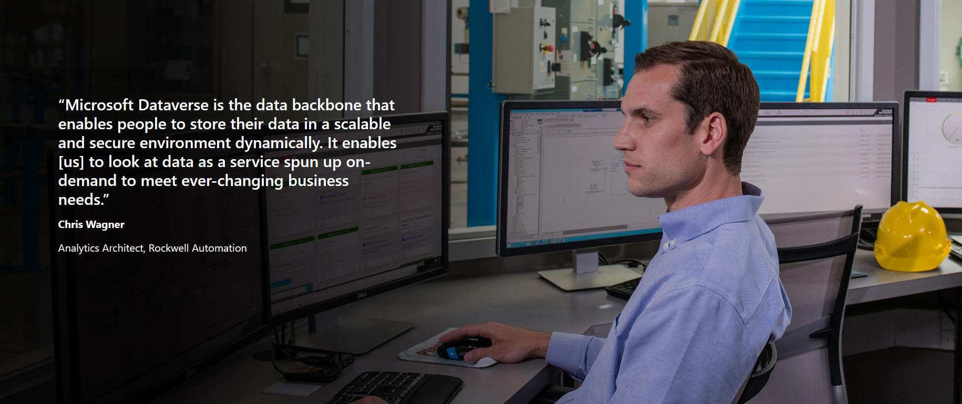

Slide 4
Looking Beneath the Hood: What is Microsoft Dataverse, Exactly?
Building a modern data infrastructure capable of performing all of the above functions while remaining agile enough to accommodate future unexpected changes can be challenging.
Today’s data hits an organization from multiple angles, in various formats, and in numerous sources. Yet you still need to derive actionable insights quickly, or you can fall behind the competition.
It can be done. It’ll not be easy to source the developers needed to create an algorithm that can bring infrastructure to life. Even if you got them, you’d have to pay a couple of thousand dollars.
Tally in the costs for deploying, configuring, and managing the finished infrastructure, and you’ll be staring at mind-blowing figures in every word. And that’s to mention the collective effort and hours your team will put in to make that dream a reality.
As depressing as that sounds, though, there’s a more straightforward solution: Microsoft Dataverse.
First announced to the world in November 2020, Dataverse (formerly CDS) was created to provide a simple, scalable, secure, compliant, end-to-end and globally available data service.
It empowers organizations to work with any data, regardless of source or format, to garner real-time, actionable business intelligence.

Slide 5
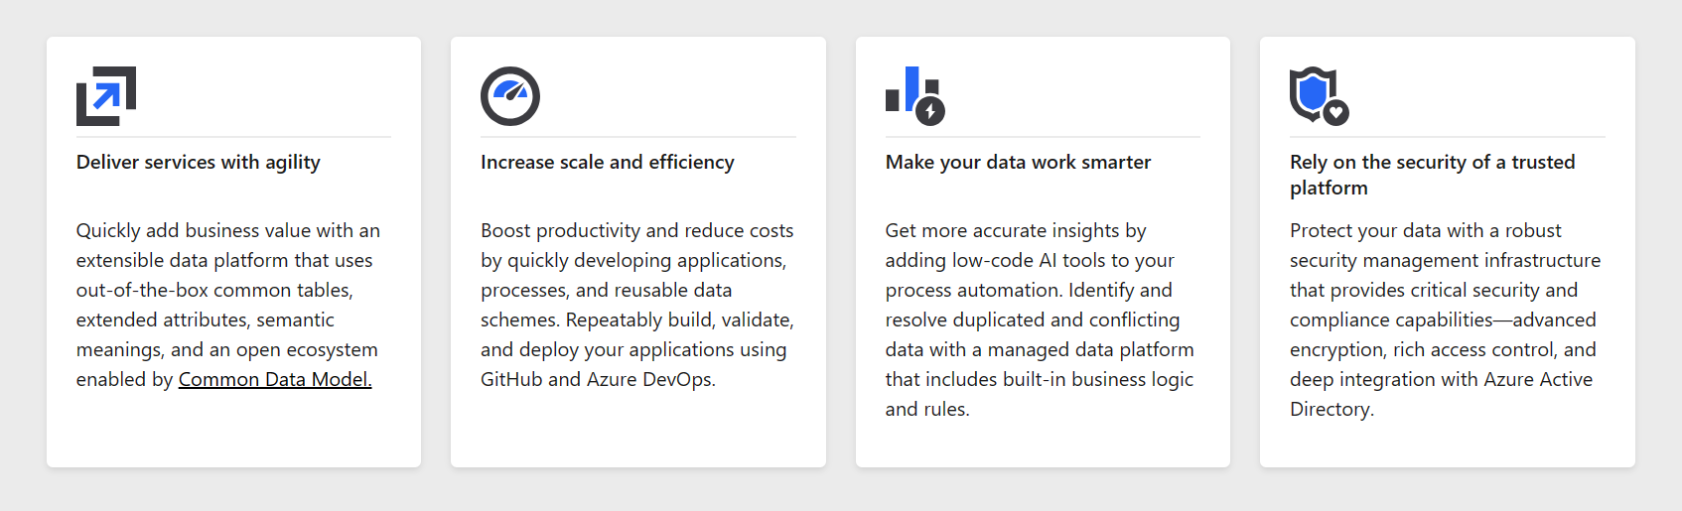
Quick Insights About Dataverse

Slide 6
What Versions of Microsoft Dataverse Are There?
Microsoft Dataverse is available in Office 365 in two versions:
Microsoft Dataverse
A premium edition that requires a PowerApps premium subscription. Allows creating apps accessible from all interfaces.
Microsoft Dataverse for Teams
This is the free edition of Dataverse. However, it has its own set of limitations, one being that it only allows the creation of internal apps.
Microsoft Dataverse is part of the Microsoft Power Platform, so it’s inherently low-code. In other words, your team can have prior programming knowledge to be able to install it and begin experiencing its ample benefits (more on this a little later).

Slide 7
How Does the Microsoft Dataverse Work?
The Dataverse is a relational database hosted in Microsoft Dynamics 365. Like any other database, it stores its data within tables. No wonder some people call it the “Microsoft Dataverse database.”
A standard table is a set of rows (formerly referred to as records) and columns (formerly referred to as attributes/fields). Each column within the table is designed to store a specific type of data, such as name, age, salary, etc.
The beauty of the Dataverse is that it incorporates a set of standard tables that cover typical scenarios you’re already familiar with. You can create custom tables unique to your organization and populate them using the Power Query. Citizen developers in your team can then use PowerApps to build rich Microsoft applications that utilize this data.

Slide 8
What Kind of Data Does the Dataverse Work With?
As we hinted earlier, the Dataverse works with any data. It also incorporates all the significant categories of data technologies that your organization needs: search, file, image, data lake, relational, and non-relational.
To ensure users have no trouble utilizing these technologies, Dataverse has a set of built-in visual designers for creating, editing, and interacting with data. This makes it easy to quickly scope out and define the tables, relationships, business processes and rules, workflows and forms, all of which come together to represent your business.

Slide 9
How Much Data Can You Store In It?
If you’re wondering how much data you can store in Dataverse, it depends. But to be sure, check your storage capacity entitlement and usage by database, file, and log as it appears in the Power Platform admin center.
For new subscriptions activated after April 1st, 2019, the default tenant-wide storage capacities are as follows:
Dataverse for apps database: 3GBDataverse for apps file: 3GB Dataverse for apps log: 1GB
As for Microsoft Dataverse storage pricing, that solely depends on your specific PowerApps licensing plan. With the per-user plan, for instance, you get to enjoy the rights to use the Dataverse as a data source with a larger capacity. The cost for this is around $20/user/month.
Put differently, if you’re using PowerApps, you already have a license covering Dataverse. So you don’t need to pay anything extra.

Slide 10
Is Microsoft Dataverse Secure?
Microsoft Dataverse is a cloud-based, low-code data platform for deploying business logic to data pipelines. Dataverse offers immense scalability with state-of-the-art security and networking features. It provides flexible solutions for data and business-related problems and is designed to be the prime data repository for business-oriented data. A wealth of Microsoft’s solutions like Microsoft Dynamics 365, Power Automate, and Microsoft Azure support connectivity and congenial compliance with Dataverse.
Need for Dataverse
Data is the building block of the modern business landscape. All operations ranging from product marketing to development are centered on the contours of data. Data is generated from a wide variety of sources: applications, services, and even SaaS applications. This huge repository of data needs to be collected, segregated, explored, analyzed and visualized to be harnessed for the good of the organization. Different types of data require different storage and analysis media. This means that you cannot analyze or store unstructured data the same way you analyze and store structured data. Consequently, rigorous data infrastructure is needed to harness the different types of data from different sources so that they could be put to use in the business scenario.
Microsoft Dataverse is the one-stop destination for harnessing a broad variety of data being generated across different domains throughout the globe. It provides a flexible, scalable, and secure SaaS platform for thorough data handling. Moreover, its simplistic UI renders it extremely easy to leverage and integrate with other data platforms and solutions like Power.

Slide 11
Why Use Dataverse?
All data types supported
Microsoft Dataverse supports all kinds of data, from files, images, blobs to relational databases and data lakes. Dataverse comes with a pile of enterprise-ready services like table automation, and multi-platform integration that facilitate its purpose.
App Integration
Dataverse is often integrated with other Microsoft technologies like Power Apps for workflow automation. This is extremely useful if the data collected and analyzed in Dataverse shall be used to drive certain enterprise pipelines. Dataverse is already integrated with prominent Microsoft solutions like Dynamics 365, MS Excel, Power BI, Azure Data Factory, etc. However, it also provides a REST API, developer SDK, and a bot-based app alternative for increased functionality.
Security and Compliance
Microsoft Dataverse is built on Azure and leverages Azure’s authentication and security features like Active Directory for encryption and authenticated access. It divides data access on the basis of two models: manager and position. The security features also permit row-level and column-level sharing.
Microsoft Dataverse is a trusted SaaS data platform. All the concerned data adheres to regulatory compliances and is validated by audits and certifications.

Slide 12
Dataverse Databases
Dataverse is known for creating standardized databases which further contain tables. A Dataverse database is a cloud-based unit instance that stores data in standardized structures called tables. A table is a collection of multiple rows containing both standard and custom data. Logical columns help in handling specific aspects of the data in the rows. Multiple database instances can be created in Dataverse to store business data. Tables are extendable and customizable to adhere to business needs. These integrated business solutions can be shared with multiple partner organizations for collaborative data analysis.
Dataverse databases can support complicated data models. Tables can hold millions of items, and storage in each instance of a Microsoft Dataverse database can be extended to about 4 TBs of data, per instance(1TB=1024GB). The amount of data that is available in an instance of Dataverse is based upon the number and types of licenses the data-handlers have been issued with. Data storage is mutually pooled by all the license holders and can be shared. However, in case of an outage, additional resources could be purchased accordingly.
There are two main categories of tables.
1. Standard- Standard tables have a pre-defined layout and structure. They are created for every instance of Dataverse databases. More columns could be added to any standard table, but columns could be deleted only from custom tables.
2. Complex– Complex tables have complex workflows and pipelines, and intricate server-side business logic.

Slide 13
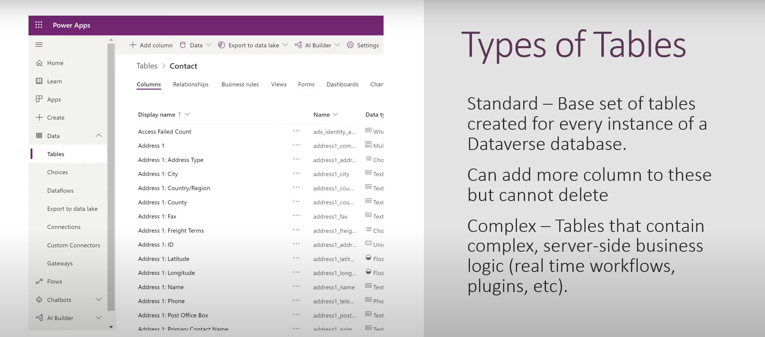

Slide 14
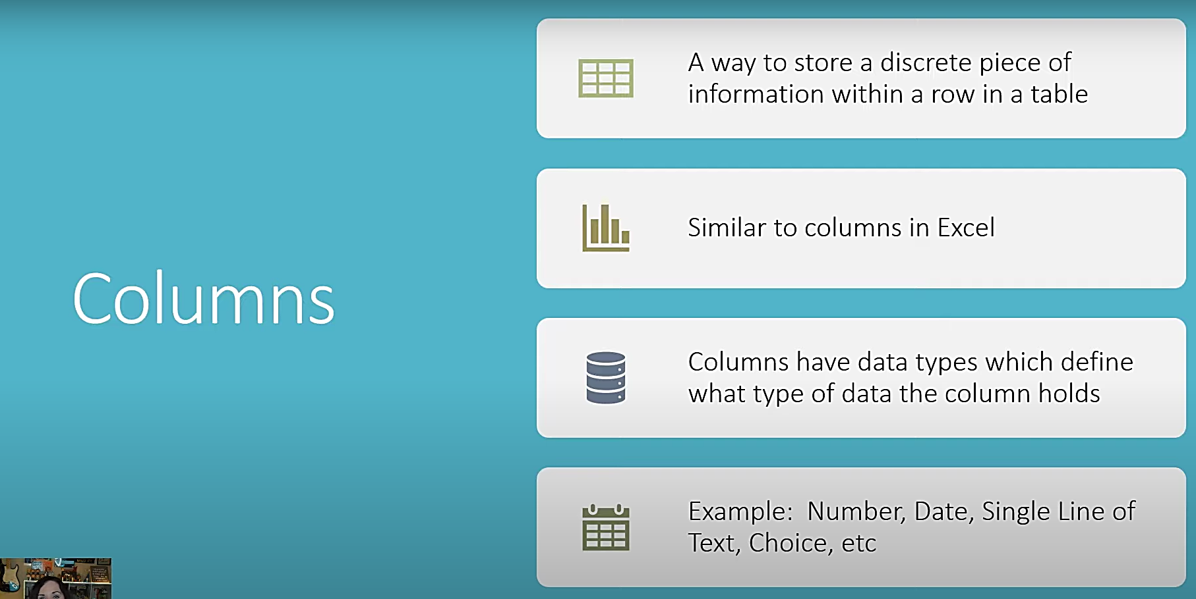
Columns in Detail

Slide 15
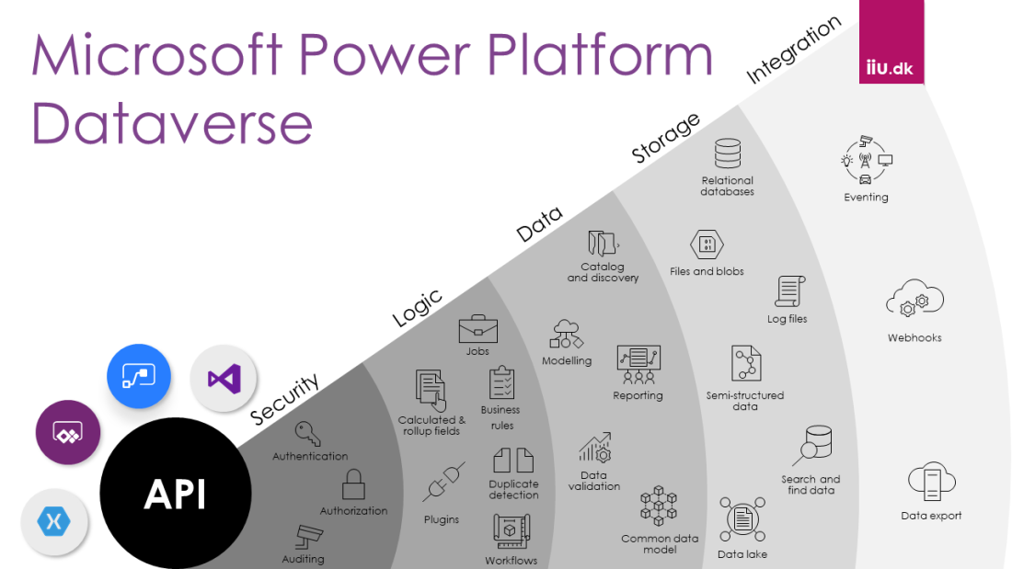


Slide 16
Features of Dataverse
1) Security
Dataverse uses Microsoft Azure’s Active Directory(AD) to ensure authenticated access and regulates data security by imposing multi-factor authentication(MFA). Azure AD allows for authentication down to the minutest blocks of the instance (rows and columns) to ensure purely authentic access to data. Auditing capabilities are also provided by Microsoft Dataverse.

Slide 17
2) Logic
Dataverse allows consumers to integrate logical inputs to their business data for directional processing. These logical rules are consistent for every purpose, ranging from redundancy detection to workflow automation.
3) Data
Dataverse is a platform that offers optimum data flexibility and scalability to model to validate business data. This allows data maximum portability and flexibility. In simpler words, this means that it can be modeled as per the wishes of the user.

Slide 18
4) Storage
Dataverse provides Azure’s fully-scalable storage facilities to the clients. This means that storage is fully-managed from the cloud end and users don’t need to be concerned about outages. Azure’s in-built services help moderate the cloud-spend to provide customized services.
5) Integration
Dataverse ensures interconnectivity with multiple interdisciplinary services that would help improve the quality of data and enable resilient data handling and management. APIs, eventing, and web-hooks help support business data.

Slide 19
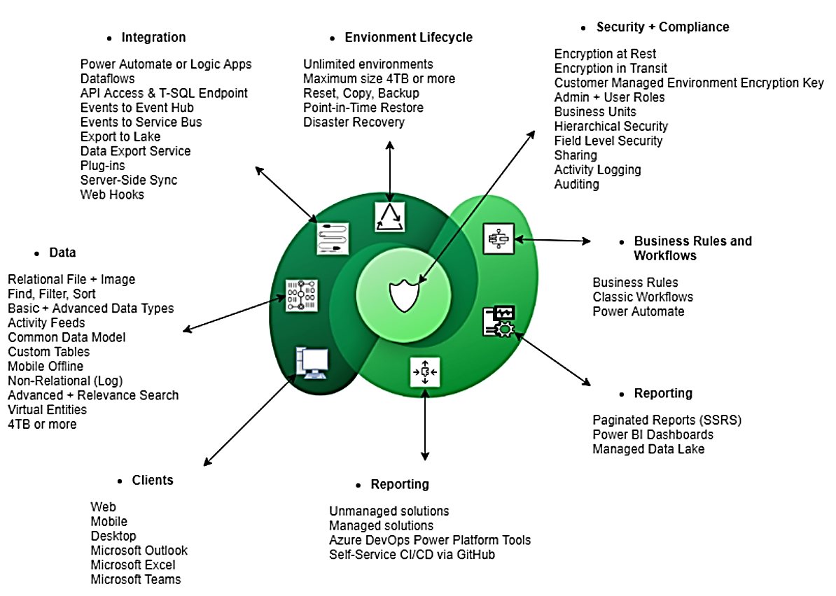

Slide 20
Relationships in Dataverse
A relationship could be established between multiple tables containing related information to improve the functionality of the solution while boosting its performance at the same time. Multiple tables could be created by splitting a larger table to simplify the workflow by discarding redundant or missing data automatically. Splitting also makes data easy to report and visualize.
There are two main types of relationships.
1. One-to-Many Relationships: A one-to-many relationship refers to the parent-child cardinality between two tables. Let us take an example of 2 tables, A and B. In our example, an element of A may have connections with many elements of B. However, a given element of B is linked to only one element of A. A can be considered to be a parent table and B can be the child table. This would imply that while A can have multiple children, B can have only one biological father/mother.
2. Many-to-Many Relationships: This cardinality can be established between two tables A and B, wherein multiple elements of A can be connected with multiple elements of B, and vice-versa. A valid example of this could be the relationship between customers and the products purchased. One customer could purchase multiple products and one class of products ( for eg: Twarita Tech Data Analytics course) could be purchased by multiple customers.

Slide 21
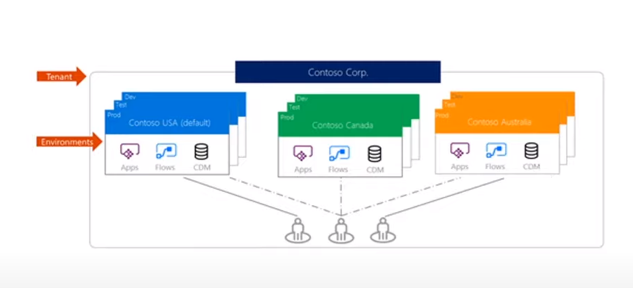
Environments in Dataverse
An environment is a virtual space set up by Microsoft Dataverse to store, manage, and share business data particularly integrated with the Power Platform. One Dataverse database could be provisioned per environment. The environment manages access, storage, and security associated with that database.
It is important to note that these resources could be only be configured and utilized within the given environment by authenticated users. Environments are bound to geographical locations and databases are created in the data-centers corresponding to those geographical locations. More than one environment could be created for separate workflows like development, testing, and production.

Slide 22
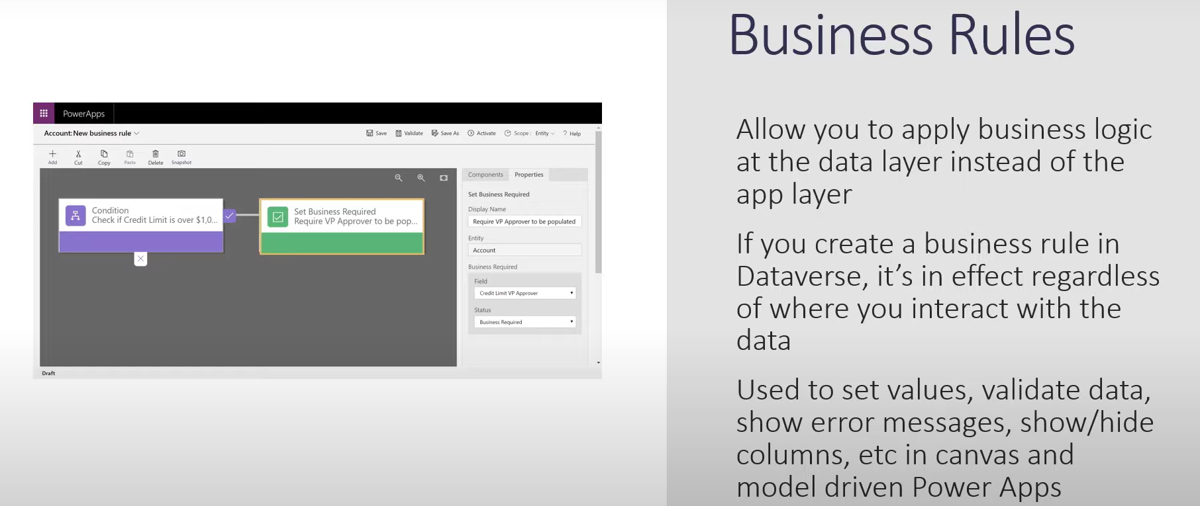

Slide 23
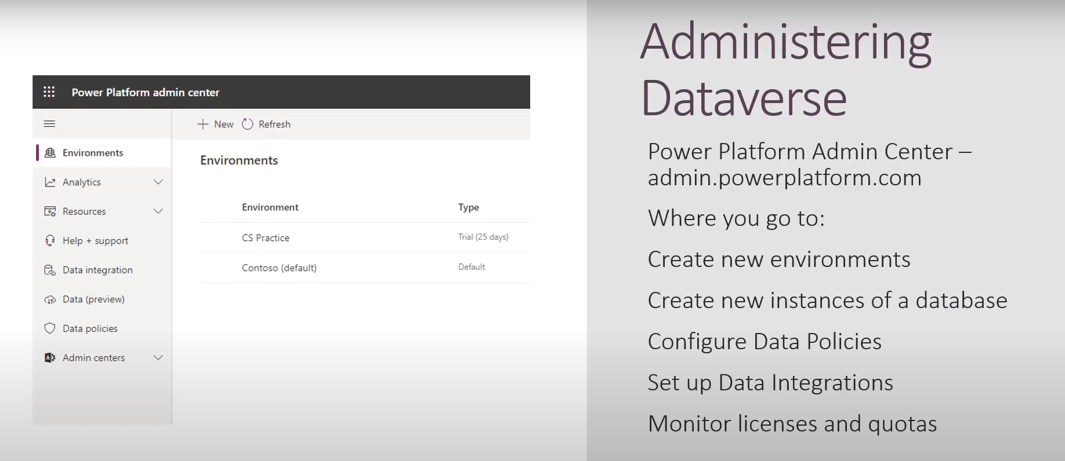

Slide 24
When Should You Not Integrate Dataverse?
While Dataverse has proven to be an extremely efficient service, there are times when using Dataverse is not required.
Dataverse, in itself, is not a database. Therefore, some Azure database services like CosmosDB would need to be integrated with it. If you do not wish to include the database, Dataverse would be rendered inefficient.
There is always some limit to storage capacity in Dataverse when it is integrated with third-party services like Microsoft Teams.
Premium and Licensing featured are costly, and could not be used if the user is on a budget.
Under these situations, other Microsoft services like Power BI could be leveraged. However, Dataverse has a diverse set of advantages and its integration is definitely a boon.

Slide 25
Microsoft Dataverse pricing
Pay-as-you-go plan
This plan is priced at $120 per active user per app per month. You need a Microsoft Azure subscription to pay. The pay-as-you-go plan is ideal for businesses that want the flexibility and agility to pay only when they run an app during a monthly period.
Subscription plan
The subscription plan is best suited for businesses that need predictable user-based licensing. Subscription plans are available in two formats:
Per app plan: $5 per user per app per month. You get one app per user. This plan includes 250 AI Builder service credits per month.
Per user plan: Flat monthly fee of $20 for unlimited apps per user. This plan includes 500 AI Builder service credits per month.
The two versions of Microsoft Dataverse

Slide 26
Thank You!!

